Slide 1
3D Printing & Designing Workshop
by Sunway Robotics Club
Notes:
Last Official Edit [3/7/2024 by Misha]
-Before starting, committee is to check whether everyone has ultimaker cura installed on their machines
-adjust the flow, spend more time for tinkercad, lesser for ultimaker cura
-This is expected to be done within 2.30 hours

Slide 2
Introduction
01
How is 3D printing utilised
Types of 3D printers
Types of printing materials
Common printing issues
Types of file formats
02
Tinkercad Setup
Account Creation
Fiddling with Tinkercad web interface
Hands on Designing
03
Learn to create a small ice cream keychain
Do-it-yourself session
Printing Application
04
Understanding Cura’s printing menu
Common Settings to look out for
Do’s and Don'ts during printing

Slide 3
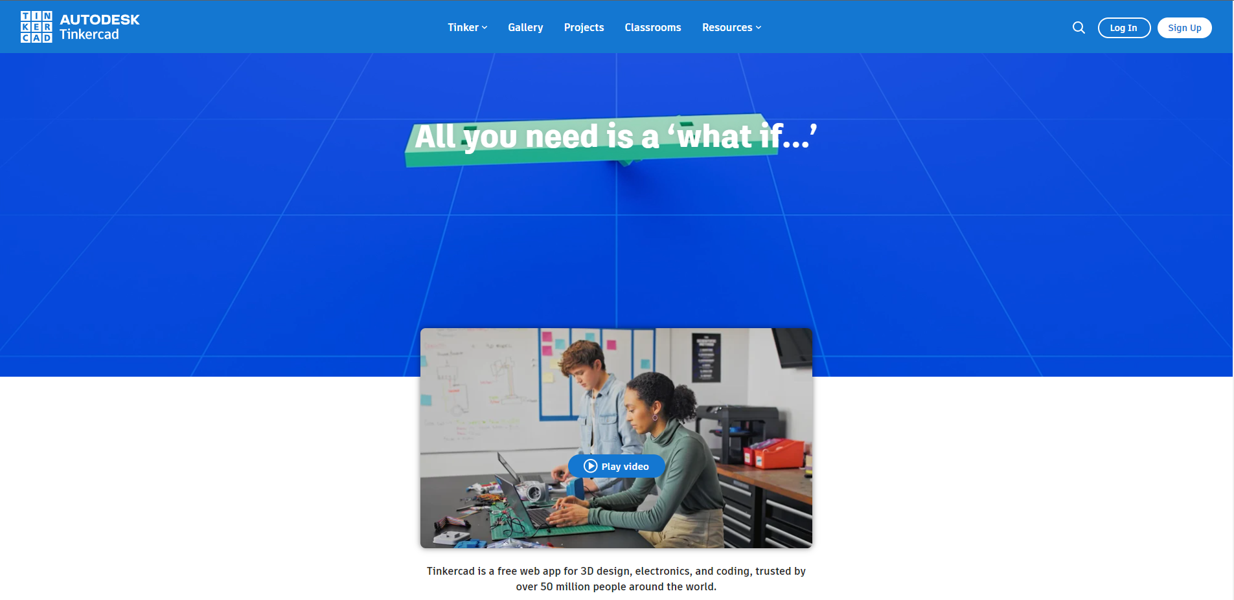
Tinkercad Setup
www.tinkercad.com
Notes:
Thi

Slide 4
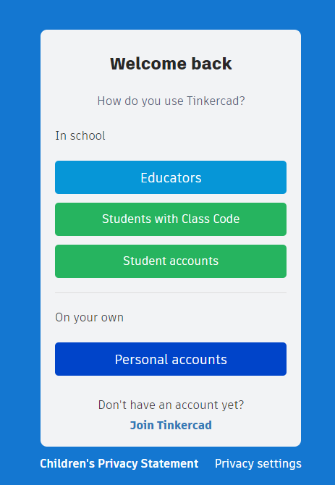
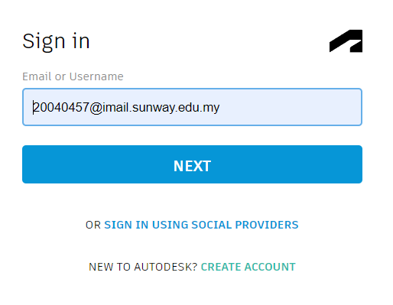
Sign Up in Tinkercad

Slide 5
Understanding TinkerCAD
Always, Losing you game pieces(dice and chess pawns)? Never again! Today we will be designing a simple 6 sided die and a chess pawn!
Notes:
-Then teach them how to design a small ice cream while showing the design functions

Slide 6
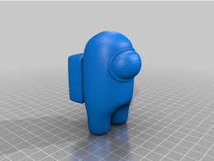
Hands On Designing Session
Utilizing the functionalities shown earlier, have fun designing a model of your choice within the measurements of
4cm x 4cm x 4cm!
(Maybe an Among Us Character?)

Slide 7
How can I get started?

Slide 8
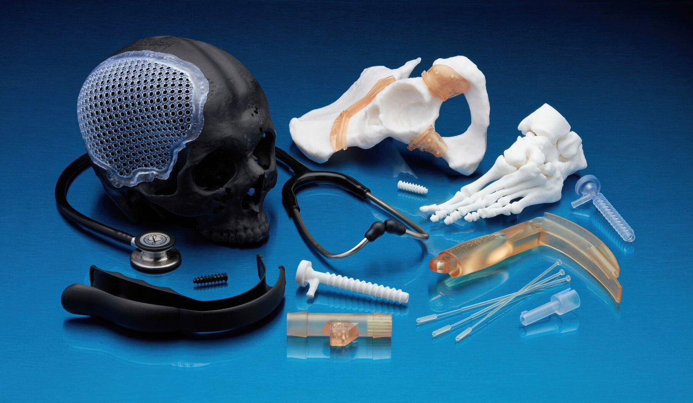
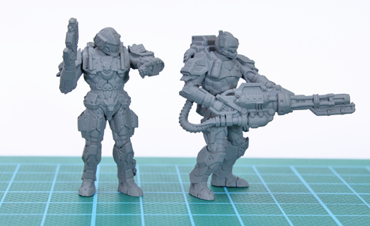
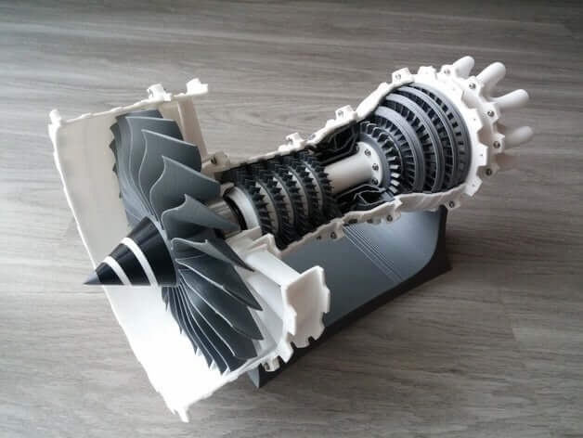
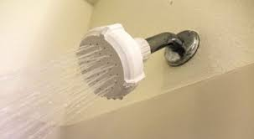

How is 3D printing utilised?
Medical Applications
Figurine/Art Models
Prototype for Real World Applications
Functional Prints
Food
Notes:
FELIX Food 1.6 SINGLE Head 3D Printer in the NetherlanDS

Slide 9
Questions to ask before starting 3D printing?
What is it used for?
Is it a complex design? Or is it a simple design?
Is this for prototyping purposes?
How long do I want it to last?
How tough or brittle should the print be?

Slide 10
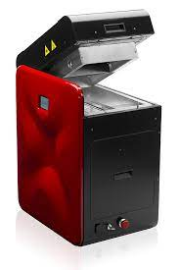
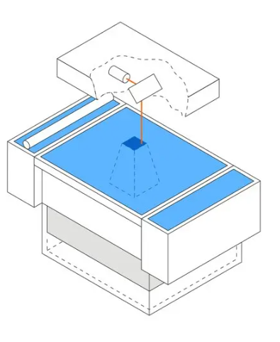
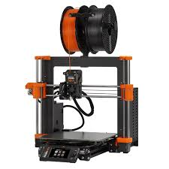
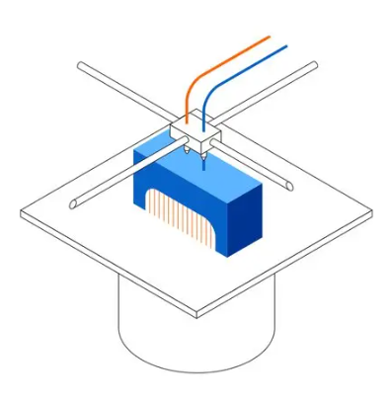
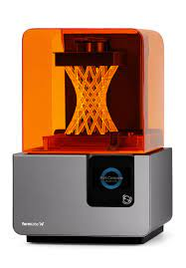
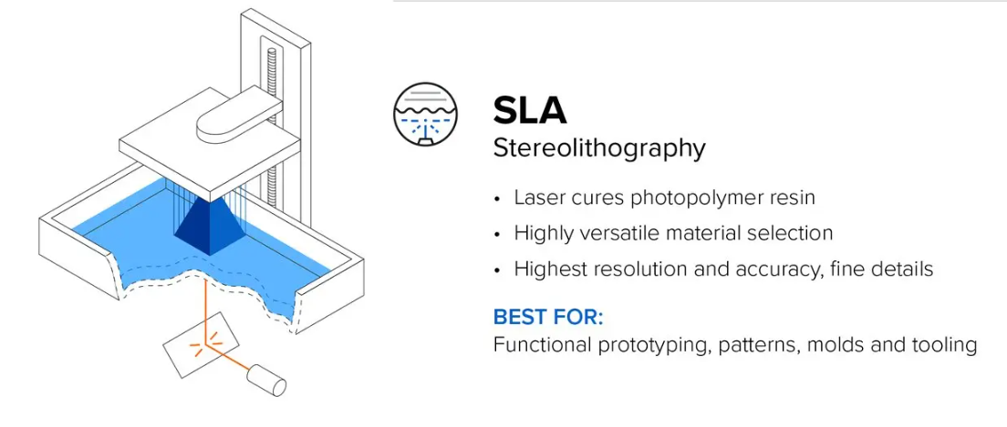
Types of Printers
SLS Printer
FDM Printer
SLA Printer
Utilizes laser to fuse polymer powder
Most expensive printer and materials over time
Excellent print integrity
For functional prototyping and end-use production
No support needed
Deposits filaments layer by layer
Cheapest printer and materials
Lowest Resolution and Accuracy
Usually for prototypes
Support needed
Laser cured resin liquid
High printer and material cost
Highest resolution and accuracy and fine details
For functional prototyping, molds and tools
Support needed

Slide 11
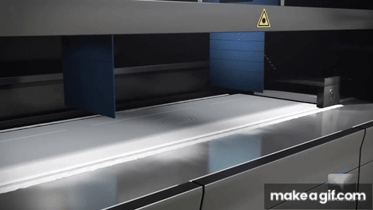
Types of Printers (SLS Printer)

Slide 12
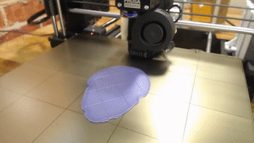
Types of Printers (FDM Printer)

Slide 13
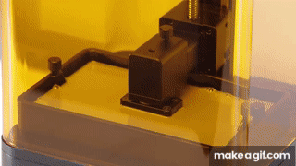
Types of Printers (Resin Printer)

Slide 14
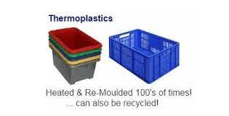
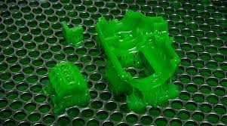
Types of Commonly Used Materials
Thermoplastics
PLA
ABS
PETG
Thermosetting Plastics
Clear/Draft Resins
Medical Resins
Nylon Composites
Can be broken down and re-printed!
Cannot be broken down and re-used!

Slide 15
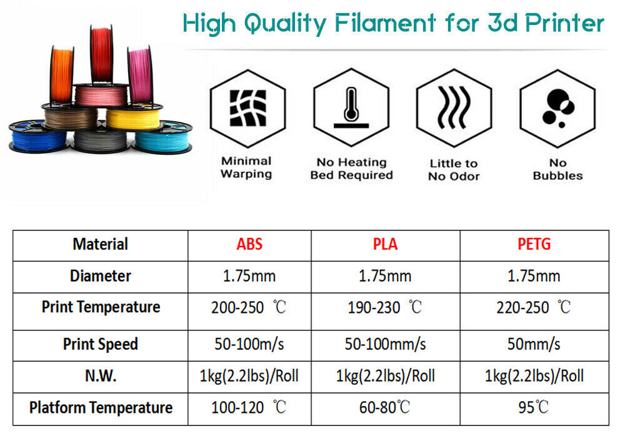
Comparison of Thermoplastic properties

Slide 16
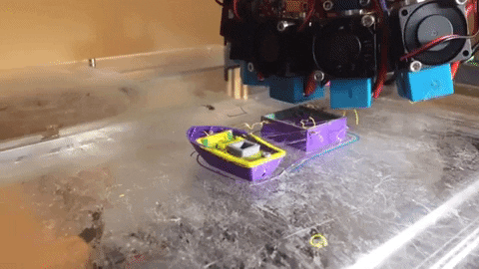
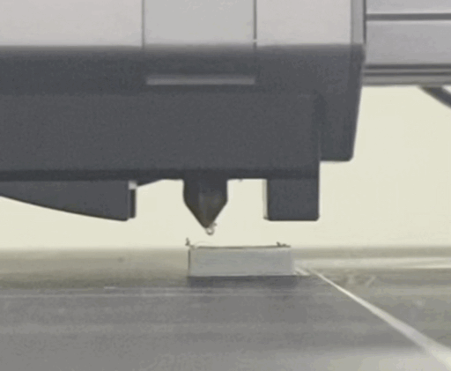
Common Printing Issues
Stringing
Nozzle Blocked
Notes:
-sometimes different material, can emit toxic fumes while printing, so be sure to keep your environment well ventilated
-prefer a video to show differences

Slide 17
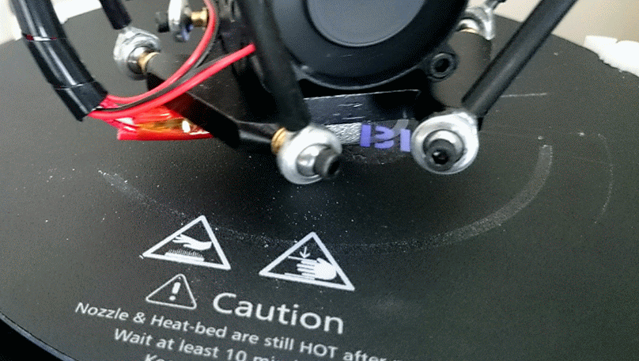
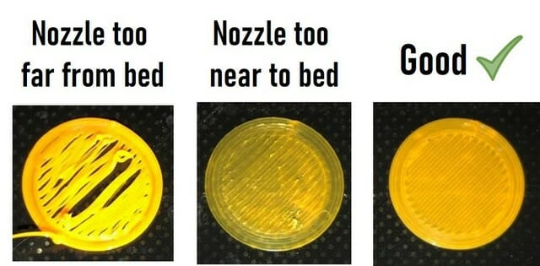
Common Printing Issues
Nozzle grinding

Slide 18
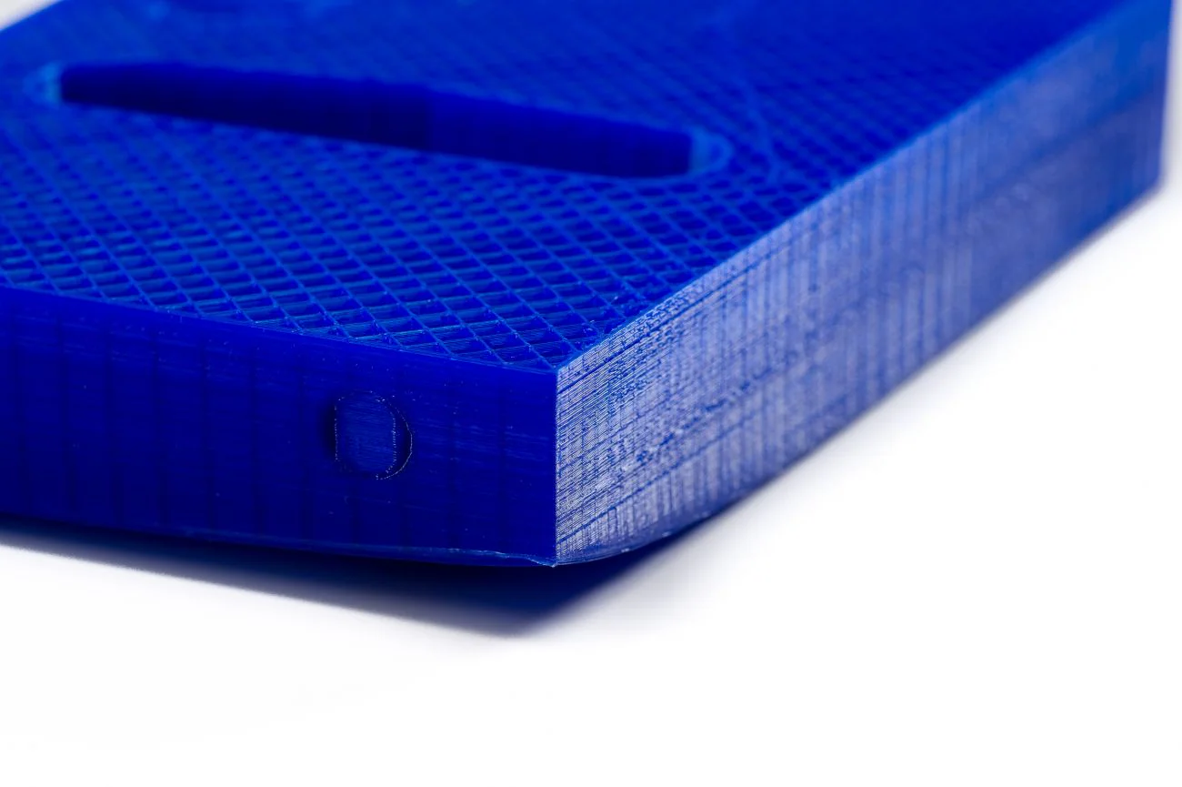
Common Printing Issues
Warping
Notes:
image source: https://discountbloc.ru/archive/products/x0x0v13yvu3x.html
-sometimes different material, can emit toxic fumes while printing, so be sure to keep your environment well ventilated
-prefer a video to show differences

Slide 19
Types of File Formats
[Most Commonly Used]
.Obj File
.Stl File
.3MF File
.AMF File
Stores 3D geometry data
Widely supported & easy to work with
Does not store unit measurements
Similar to Obj, doesn’t store color, texture, material information
Widely supported
Stores color, texture, material information and geometry
Supports advanced features (multi-material models)
Machine and human readable
Allows for advanced features & highly versatile
Suitable for industry based usage
Not yet widely supported

Slide 20



Websites for 3D prints
Community Driven
Widely Free
Modelers may sell their designs
Wider user base, ranging from beginners to professionals
3D Printing Marketplace
Mostly paid
Attracts more professional and hobbyists
www.thingiverse.com
www.cults3d.com
3D printing, gaming models, architecture models marketplace
Mostly paid
Used by Professional Modellers, Companies, Designers
www.cgtrader.com

Slide 21
Introduction to Cura’s Printing Menu

Slide 22
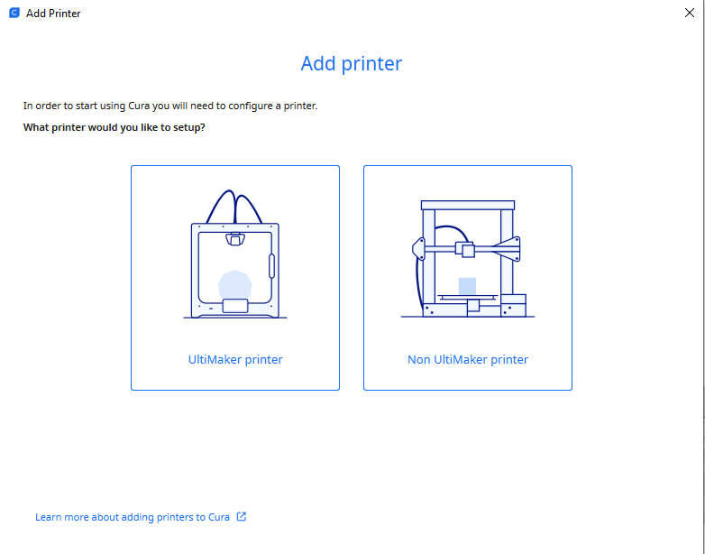
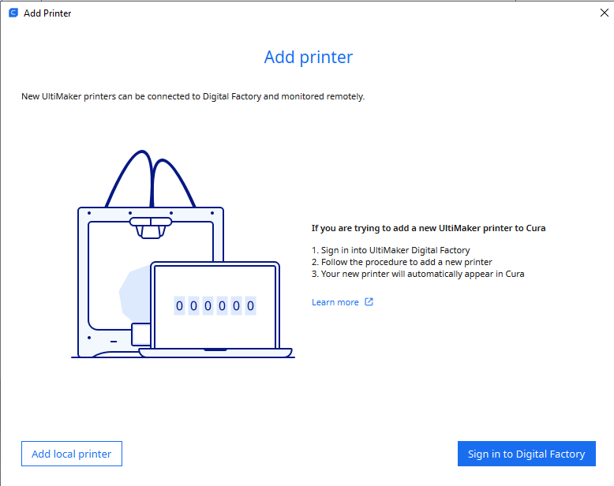
Ultimaker Cura Set Up
Step 1 Select: Ultimaker Printer
Step 2 Select: Add Local Printer
Notes:
-live demonstration of cura’s printing menu -talk about supports and post pro-cessing

Slide 23
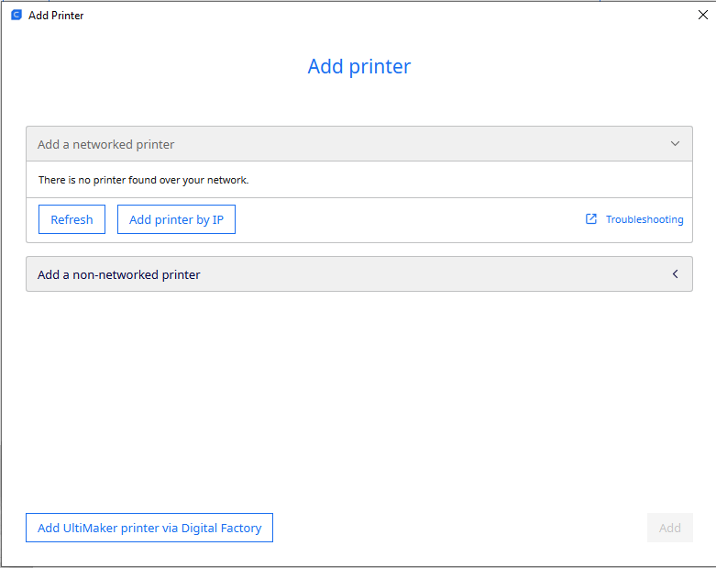
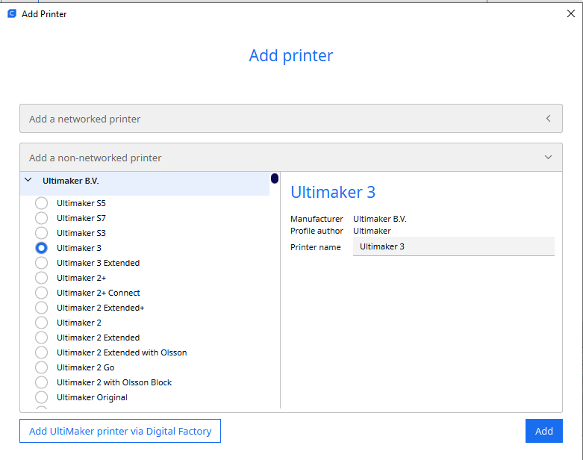
Step 3 Select: “Add a non-networked printer”
Step 4 Select: “Ultimaker 3 & Add”

Slide 24
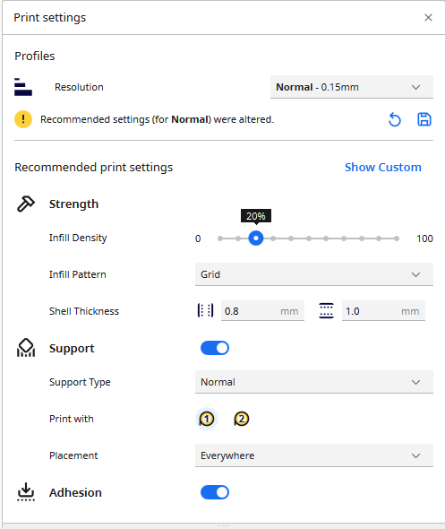
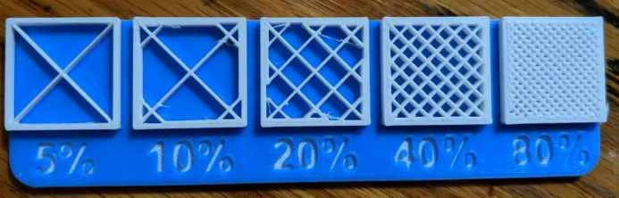
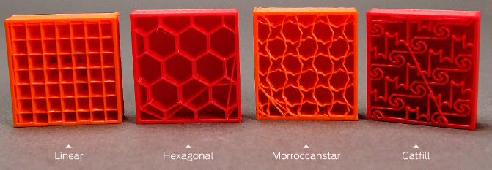
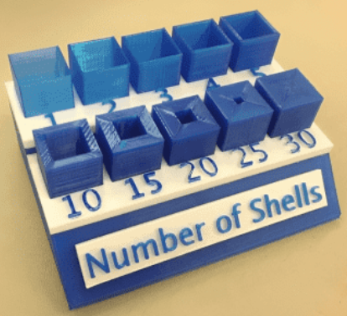
A Guide to Infill
Infill refers to “material that fills a space or hole”
Density
Pattern
Shell
Notes:
-Density talk about fill, the strength, when would you adjust strength for? -Pattern talk about structural integrity and print time
-Shell refers to the outer layer of the print, (i.e the cell wall)

Slide 25

A Guide to Supports
A support structure is the
“added part that supports the overhanging structure or bridge structure when slicing the model, which needs to be removed after printing”
Support Types
Placement Types
Touching build plate: Support material is only printed from the build plate up.
Everywhere: Support material is printed below every part that needs support, which means that it can also be placed on or inside a model.
Notes:
-Mention what is support for
-print refers to PLA filament 1, and PLA filament 2

Slide 26

A Guide to Adhesion
Adhesions are used to ensure your prints are stuck onto the build plate safely and prevents it from being deformed during extraction or cooling.

Slide 27
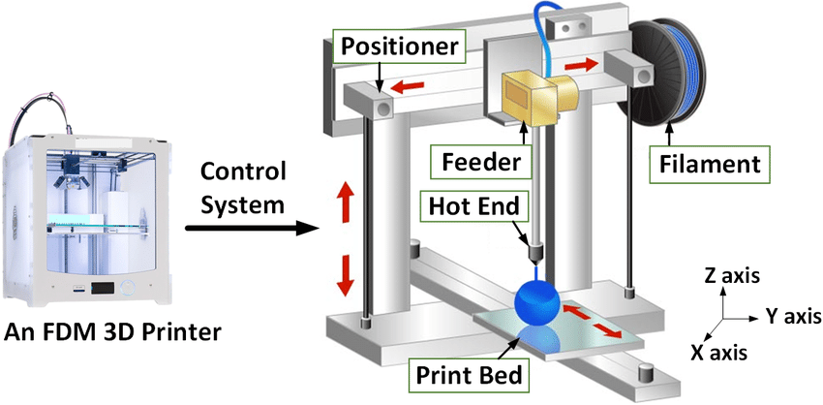
Printing Application
Notes:
This is to give an overview to students on what is usually included in an FDM 3D printer, bring them to the printer, and talk about which part is what part

Slide 28
Do’s and Dont’s During Printing
Do’s
Understand the printer’s tolerance
Calibrate and check your printer’s settings
Check the print’s clearances and tolerances
Dont’s
Print your prints in the wrong direction
Design prints that are not suitable to be printed by the printer
Forget printer maintenances

Slide 29



Thank you for joining us today!
submit your feedback and your design in the link!
SunwayRobotics
sunwayroboticsclub@gmail.com
Notes:
Design Deadline Submission 24 Sept, once printed all, will email to come collect at a certain date

